Slide 1
Node.js Packages. Modules. Examples of usage
by Yurii Holskyi

Slide 2
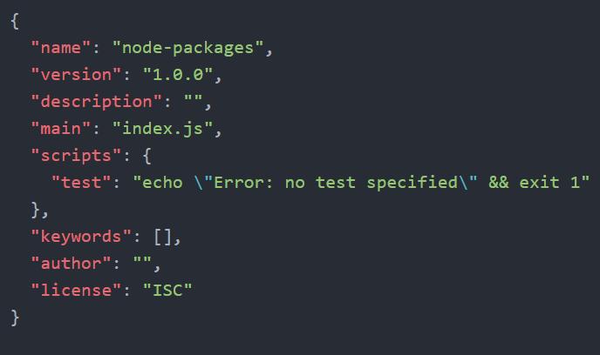
Package.json
The package.json file is core to the Node.js ecosystem and is a basic of understanding and working with Node.js, npm, and even modern JavaScript.
The package.json is used as what equates to a manifest about applications, modules, packages, and more - it's a tool to that's used to make modern development streamlined, modular, and efficient.
The command to create a package.json is npm init. (Note, you need Node.js installed)

Slide 3
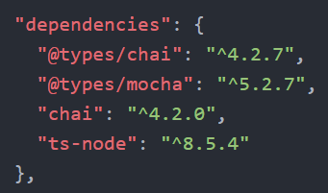
Dependencies
The dependencies property of a module's package.json is where dependencies - the other modules that this module uses - are defined. The dependencies property takes an object that has the name and version at which each dependency should be used.
The dependencies property is used to define dependencies that a module needs to run in production.
Do note that you'll frequently find carets (^) and tildes (~) included with package versions. You can look more about this on https://semver.org/.

Slide 4
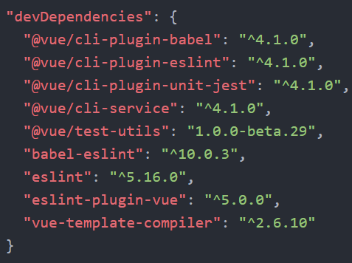
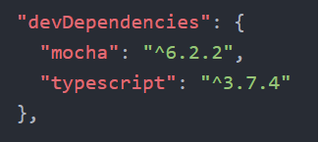
DevDependencies
The devDependencies property of package.json is almost identical to the dependencies property in terms of structure, with a key difference. The dependencies property is used to define the the dependencies that a module needs to run in production. The devDependencies property is usually used to define the dependencies the module needs to run in development.

Slide 5
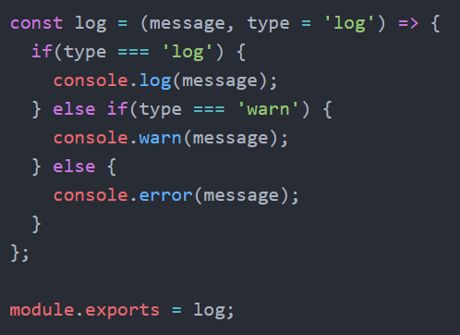
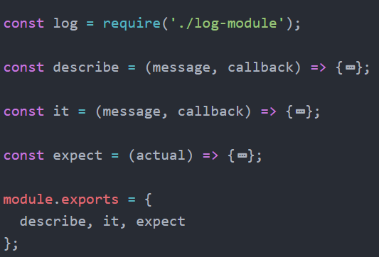
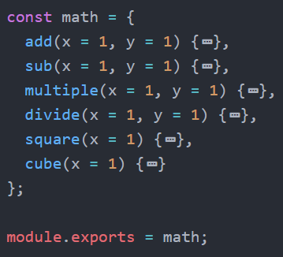
Local Modules
You can create local modules. It’s just a .js file with some logic.

Slide 6
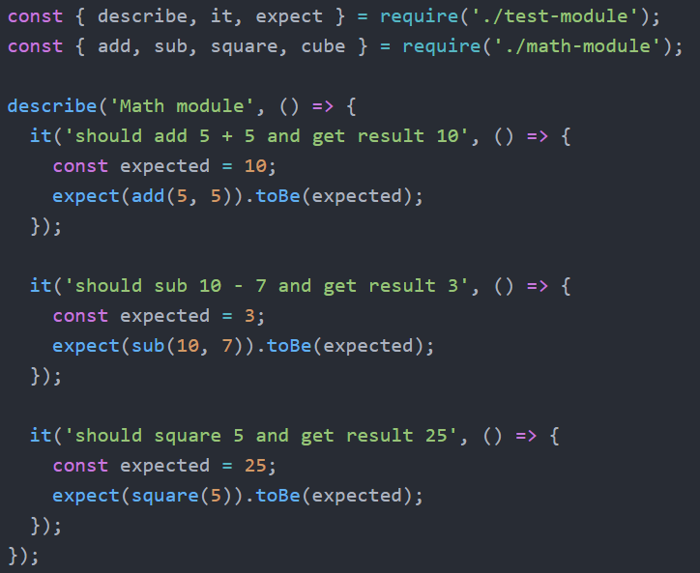
Modules usage
For using local modules you need required them.

Slide 7
Built-in modules
In node.js we have many built-in modules:
1. path (to handle file paths);
2. fs (to handle file system);
3. http (to make Node.js act as an HTTP server);
4. querystring (to handle URL query strings);
5. url (to parse URL string).
And so on.

Slide 8
External module
For using external you must first install them.
To install development module command:
npm install --save(for new version you can omit --save) express.
To install production module command:
npm install --save-dev(or -D) eslint.

Slide 9
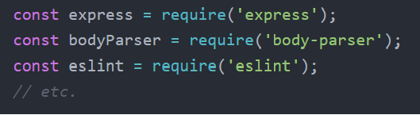
External module usage
Usage the same as for local packages:
In external module we use absolute path and all packages lay in node_modules folder.

Slide 10
Thank You.

